Slide 1
Link prefetching: a website fingerprinting defense for Tor Vaibhav Sharma, Taejoon Byun, Se Eun Oh and Elaheh Ghassabani Final project of CSCI5271: Introduction to Security 7th December 2015

Slide 2
Outline
Overview
Anonymity network
Website fingerprinting attack
Related works
Link prefetching
Experiments
Conclusion and contribution
Future works

Slide 3
Overview
Do we need an overview slide?
CFAR is an a
Do we
[1] Carzaniga et al., “Automatic Recovery from Runtime Failures”, ICSE, 2013.

Slide 4
Anonymity Network
Why Anonymize?
Internet is not anonymous by its design
[1] Carzaniga et al., “Automatic Recovery from Runtime Failures”, ICSE, 2013.

Slide 5
Anonymity Network
Anonymity use case
Normal people
Circumvent censorship
Skirt surveillance
Protect privacy from identity theft (ISP, websites …)
Citizen journalists (in repressive nations)
Activist and whistleblowers
Military
Intelligence gathering
(geographically) Hidden services
https://www.torproject.org/about/torusers.html.en

Slide 6
Anonymity Network
How Tor works
Tor node
Unencrypted
Encrypted
Alice
1. Alice's Tor client obtains a list of Tor nodes from a directory server.
Charlie
Bob
https://www.torproject.org/about/overview.html.en#thesolution

Slide 7
Anonymity Network
How Tor works
Tor node
Unencrypted
Encrypted
Alice
2. Alice's Tor client picks a random path to destination server.
Charlie
Bob
https://www.torproject.org/about/overview.html.en#thesolution

Slide 8
Anonymity Network
How Tor works
Tor node
Unencrypted
Encrypted
Alice
3. If at a later time, the user visits another site, Alice's Tor client selects a second random path.
Charlie
Bob
https://www.torproject.org/about/overview.html.en#thesolution

Slide 9
Website Fingerprinting
Attack Model
Tor node
Unencrypted
Encrypted
Alice
Charlie
Bob
https://www.torproject.org/about/overview.html.en#thesolution

Slide 10
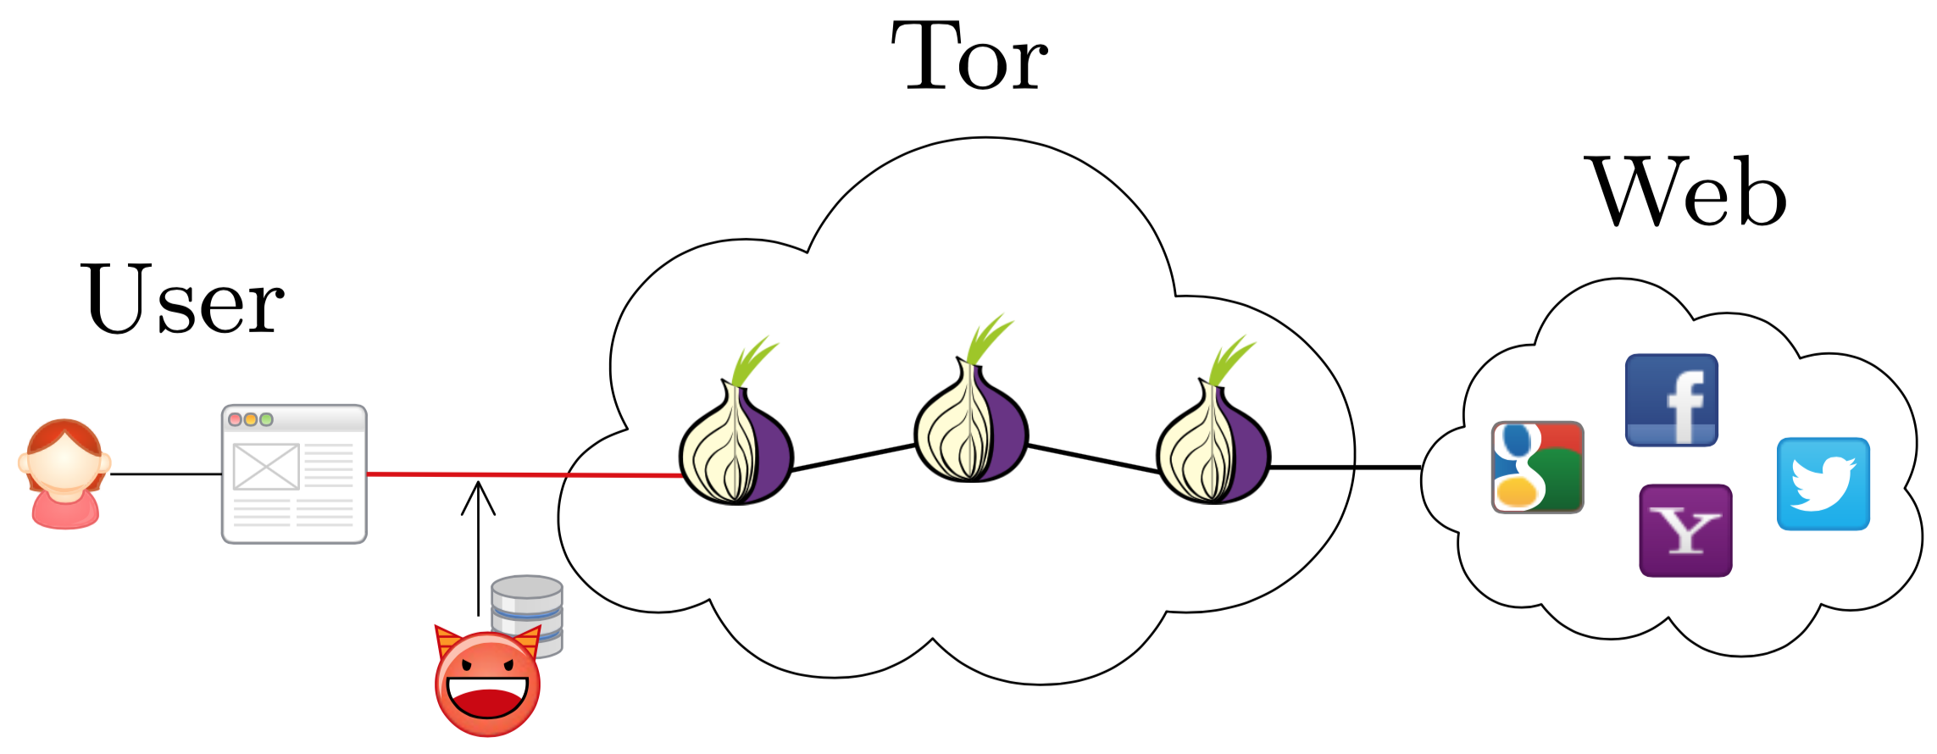
Website Fingerprinting
Attack Model
Juarez, M. et al.: A Critical Evaluation of Website Fingerprinting Attacks. (2014).

Slide 11
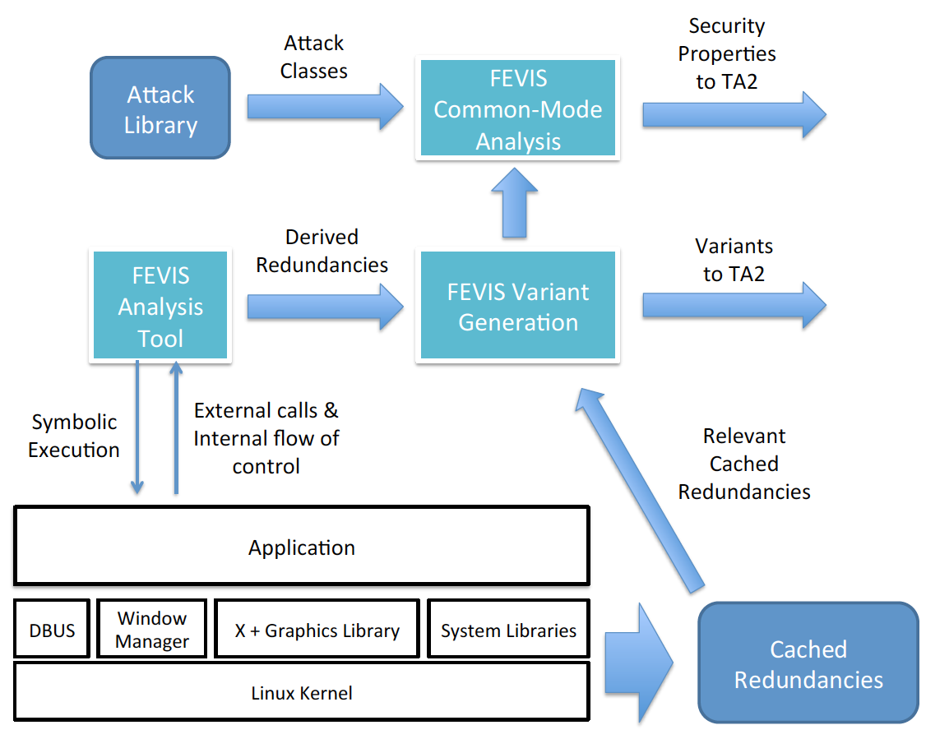
What is CFAR-FEVIS ?

Slide 12
*
An Example
of Buffer Overflow
#define LEN 10
struct file_info {
char name[LEN];
short perm;
};
Void do_something_with_file() {
struct file_info file;
char* input;
file.perm = 0744;
input = getenv(“FILE_NAME”);
if(strlen(input) <= LEN + sizeof(NULL)) {
strcpy(file.name, input);
}
chmod(file.name, file.perm);
}
* This example is a simplified version of a vulnerable program written by Dr. Stephen McCamant as a hands-on assignment in his course CSCI5271

Slide 13
*
An Example, modified
int proxy_strcpy(char* dest, char* src) {
int retval = 0;
retval = strncpy(dest, input, strlen(dest)-1);
dest[strlen(dest)-1] = ‘\0’;
return retval;
}
void do_something_with_file() {
struct file_info file;
char* input;
file.perm = 0744;
input = getenv(“FILE_NAME”);
if(strlen(input) <= LEN + sizeof(NULL)) {
proxy_strcpy(file.name, input);
}
chmod(file.name, file.perm);
}

Slide 14
What is CFAR-FEVIS ?
Lifter
Chunker
Probe Sampler
Compiler
Variant Synthesizer
Clone Validator
Clone Miner
Common Mode Analysis
Code Generator
Variant Validator

Slide 15
Now, Assure!
Assure what?
“You need to figure out what to assure by yourself”
Goal
To provide an argument and evidences that FEVIS works well in which degree
To guide the developers to develop system right.
A few of the claims that needs to be assured are …
Assure that “FEVIS actually works”.
Assure that variants generated by FEVIS is “good enough”
Variants are functionally equivalent to the original ATD
Variants diverge in the presence of attack
Variants generated by FEVIS can defend an (any?) ATD against certain classes of attacks.

Slide 16
Related Works
Automatic Recovery
Carzaniga et al., “Automatic recovery from runtime failures”, ICSE, 2013
Chen and Avizienis, “N-version programming: a fault-tolerant approach to reliability of software operation”, 1978.
Assurance Case
Weinstock and Goodenough, “Towards an assurance case practice for medical devices”, 2009.
Compositional Verification
Cofer et al., “Compositional verification of architectural model”, 2012.
Software Security Assurance
Goertzel et al., “Software security assurance: A state-of-art report”, IATAC, 2007.

Slide 17
An Assurance Case (initial draft)

Slide 18
An Assurance Case (initial draft)
Problems
Too vague, doesn’t make much sense
How can I assure if I don’t even know what to assure?

Slide 19
Glossary
ATD, which stands for Application To Defend, is the original application to generate variants from.
A chunk is a unit of code that can be replaced with another clone. (currently, we limit the unit of a chunk to a function)
An adaptor is a segment of code that compensates for interface difference of two different chunks.
A clone is a unit of code that is functionally equivalent to a chunk in the original ATD.
A variant is an application that is functionally equivalent to the ATD. An ATD variant can be synthesized by replacing any part of the original ATD with a functionally equivalent clone.
Note
The terminology is still ambiguous.
The terminology is not yet agreed among developers and other stakeholders.

Slide 20
FEVIS Requirement
Claims
CFAR can successfully detect and defend an ATD against attacks which could not have been defended originally.
Variants generated by FEVIS provide a more sensitive detection and defense in the presence of attacks.
For an Attack to be Detected and Defended,
1) For a vulnerable piece of code, there exists a clone.
1-1) There exists an equivalent chunk in the diversity cache.
1-2) An adaptor can be generated for the clone.
2) The clone is functionally equivalent to the original one.
3) The clone diverges in the presence of attack

Slide 21
*
An Example, modified
int proxy_strcpy(char* dest, char* src) {
int retval = 0;
retval = strncpy(dest, input, strlen(dest)-1);
dest[strlen(dest)-1] = ‘\0’;
return retval;
}
void do_something_with_file() {
struct file_info file;
char* input;
file.perm = 0744;
input = getenv(“FILE_NAME”);
if(strlen(input) <= LEN + sizeof(NULL)) {
proxy_strcpy(file.name, input);
}
chmod(file.name, file.perm);
}
1) For a vulnerable piece of code, there exists a clone.
1-1) There exists an equivalent chunk in the diversity cache.
1-2) An adaptor can be generated for the clone.
2) The clone is functionally equivalent to the original one.
3) The clone diverges in the presence of attack

Slide 22
FEVIS Requirement - Questions
For an Attack to be Detected and Defended,
1) For a vulnerable piece of code, there exists a clone.
How much of the code (system call, library call) can be replaced by clones in the diversity cache?
1-1) There exists an equivalent chunk in the diversity cache.
Is there enough redundancy cached in the diversity cache?
1-2) An adaptor can be generated for the clone.
How is the adaptor synthesized?
2) The clone is functionally equivalent to the original one.
How do we define functional equivalence?
How do we verify the functional equivalence of the two clones?
3) The clone diverges in the presence of attack
How do we define divergence?
How can we characterize an attack class?
How do we assure that a variant diverges under attack?

Slide 23
Ongoing Works
Formalization of system characteristics and desired properties
Define artifacts: clone, variant, adaptor, ATD
Define relations: equivalence, divergence
Define properties to be verified
Functional equivalence of clones
Divergence of clones under a certain class of attack
Devise means to characterize attack classes
Organizational(?) challenges
Set up a clear requirement document
(According to a trusted principal…) The development team relies on the proposal as the only source of document (requirement, design, use case…)
Decompose the requirements / properties to the component level
Nonexistent requirement document

Slide 24
THANK YOU

